Slide 1
Forecasting electricity demand – ensemble methods
Jérôme Emery
Update august 11

Slide 2







Ensemble methods - stacking
Create many base models, average their predictions.
Improve accuracy, reduce errors.
How to determine weights for each forecast?
$${\hat{y}}_{t}^{1}$$
$${\hat{y}}_{t}^{1}$$
$${\hat{y}}_{t}^{2}$$
$${\hat{y}}_{t}^{2}$$
$${\hat{y}}_{t}= \sum_{i=1}^{4}{α_{i}{\hat{y}}_{t}^{i}}$$
$$y_{t}$$
$$y_{t}$$
$${\hat{y}}_{t}$$
$${\hat{y}}_{t}^{3}$$
$${\hat{y}}_{t}^{3}$$
$${\hat{y}}_{t}^{4}$$
$${\hat{y}}_{t}^{4}$$

Slide 3
Individual models
Regression splines – piecewise linear regression with weather data.
Fourier series – Fitting the terms of different fourier series to the load data.
MLP – Basic neural network for regression on weather data
SARIMAX: Autoregressive model.

Slide 4
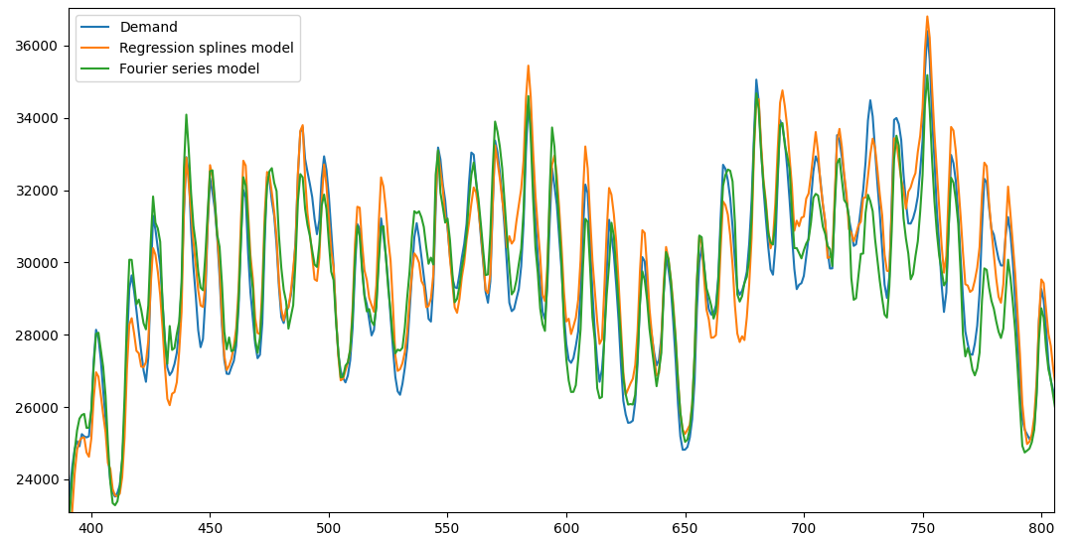
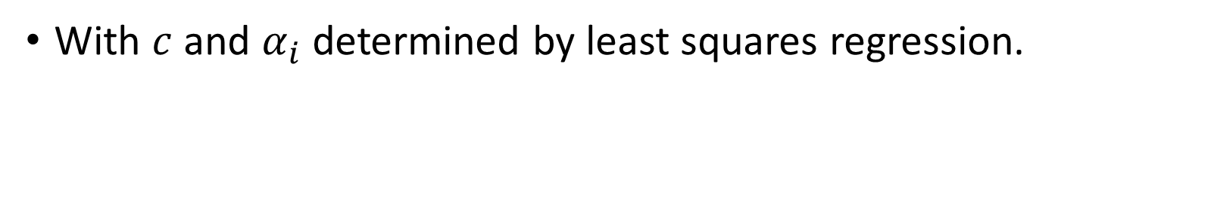
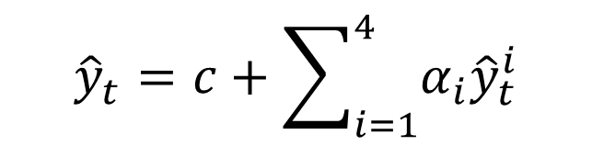
Rolling window linear regression
30 days
$${\hat{y}}_{t}=c+\sum_{i=1}^{4}{α_{i}{\hat{y}}_{t}^{i}}$$
With $c$ and $α_{i}$ determined by least squares regression.

Slide 5
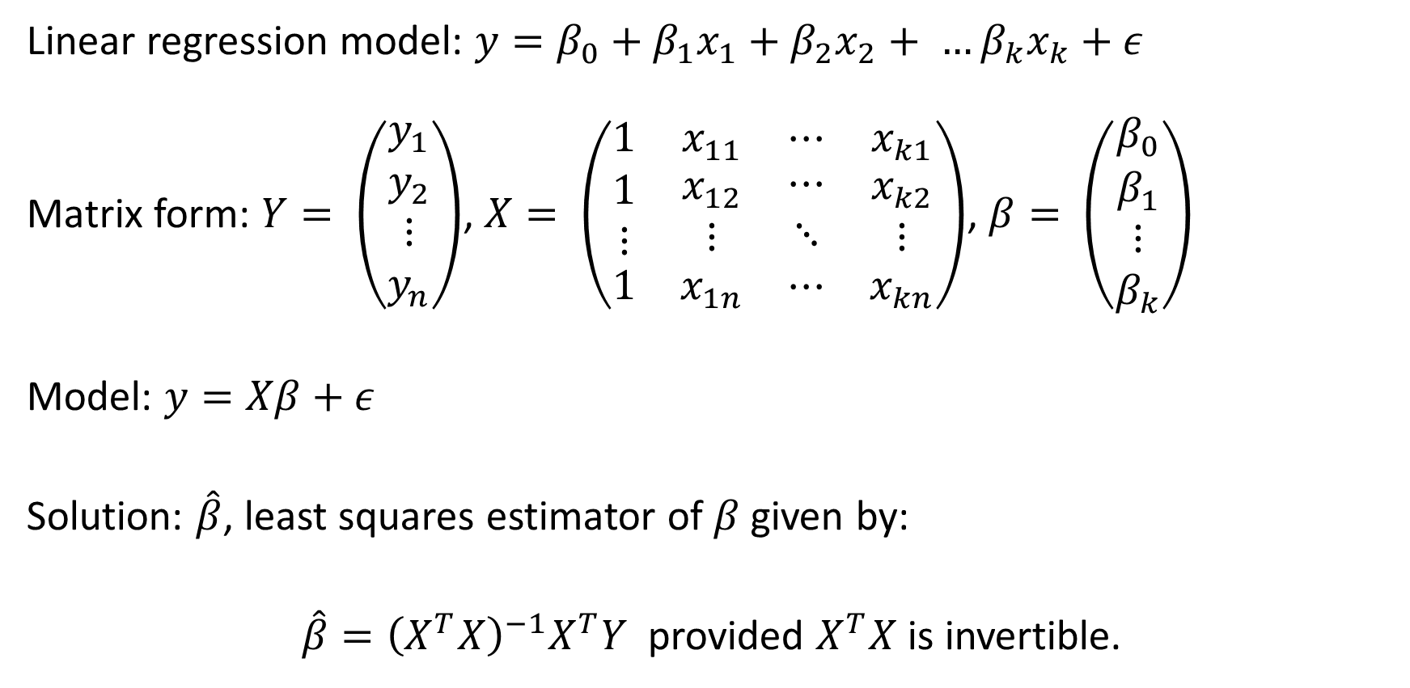
Least squares regression
Linear regression model: $y=β_{0}+β_{1}x_{1}+β_{2}x_{2}+ …β_{k}x_{k}+ε$
Matrix form: $Y= \left(\begin{aligned}y_{1} \\ y_{2} \\ ⋮ \\ y_{n}\end{aligned}\right)$, $X= \left(\begin{matrix}1 & x_{11} & ⋯ & x_{k1} \\ \begin{aligned}1 \\ ⋮\end{aligned} & \begin{aligned}x_{12} \\ ⋮\end{aligned} & \begin{aligned}⋯ \\ ⋱\end{aligned} & \begin{aligned}x_{k2} \\ ⋮\end{aligned} \\ 1 & x_{1n} & ⋯ & x_{kn}\end{matrix}\right)$, $β= \left(\begin{matrix}β_{0} \\ \begin{aligned}β_{1} \\ ⋮ \\ β_{k}\end{aligned}\end{matrix}\right)$
Model: $y=Xβ+ε$
Solution: $\hat{β}$, least squares estimator of $β$ given by:
$\hat{β}={\left(X^{T}X\right)}^{−1}X^{T}Y$ provided $X^{T}X$ is invertible.

Slide 6
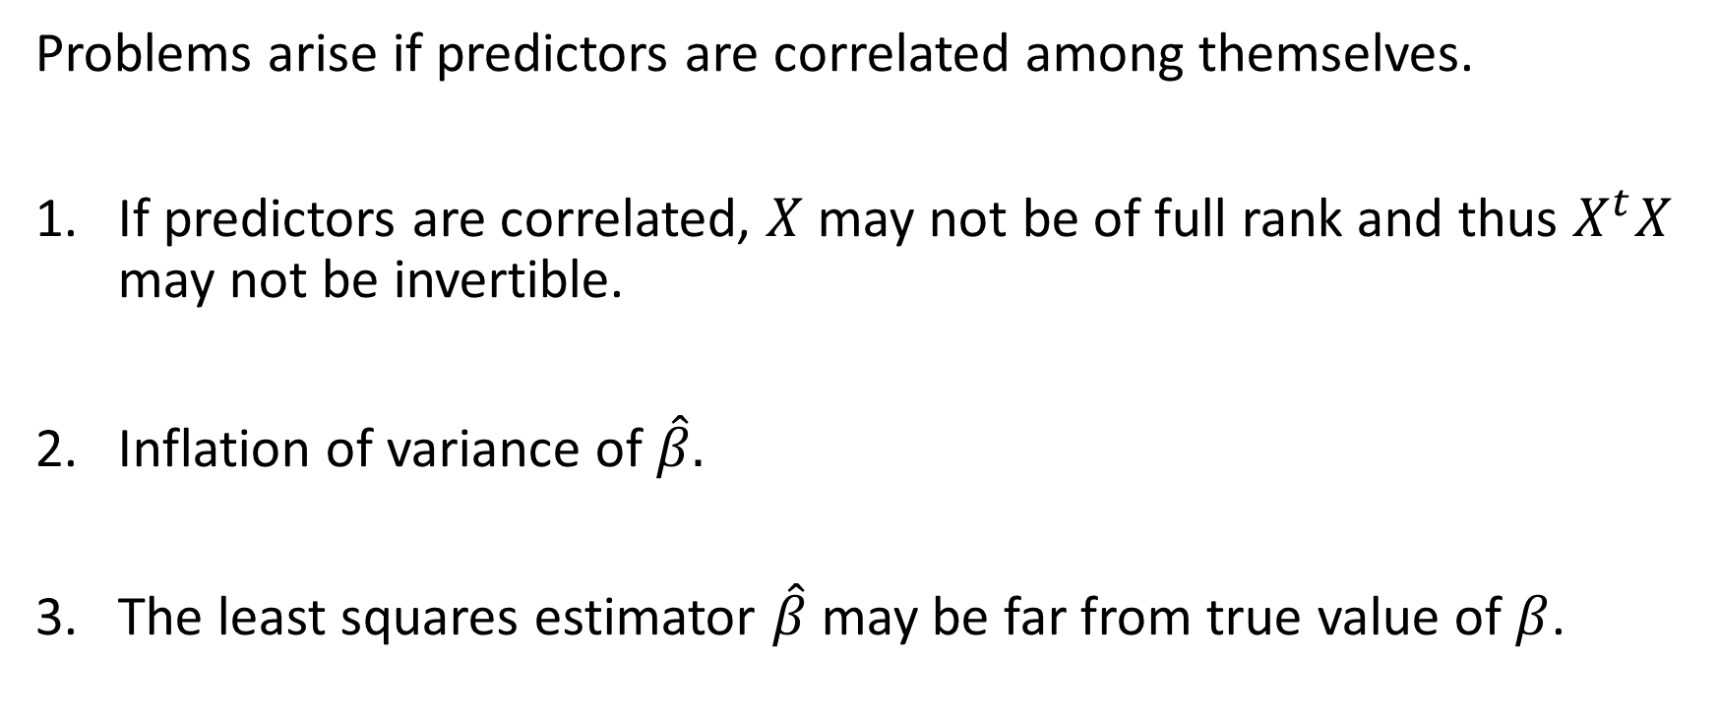
Multicollinearity
Problems arise if predictors are correlated among themselves.
If predictors are correlated, $X$ may not be of full rank and thus $X^{t}X$ may not be invertible.
Inflation of variance of $\hat{β}.$
The least squares estimator $\hat{β}$may be far from true value of $β$.

Slide 7
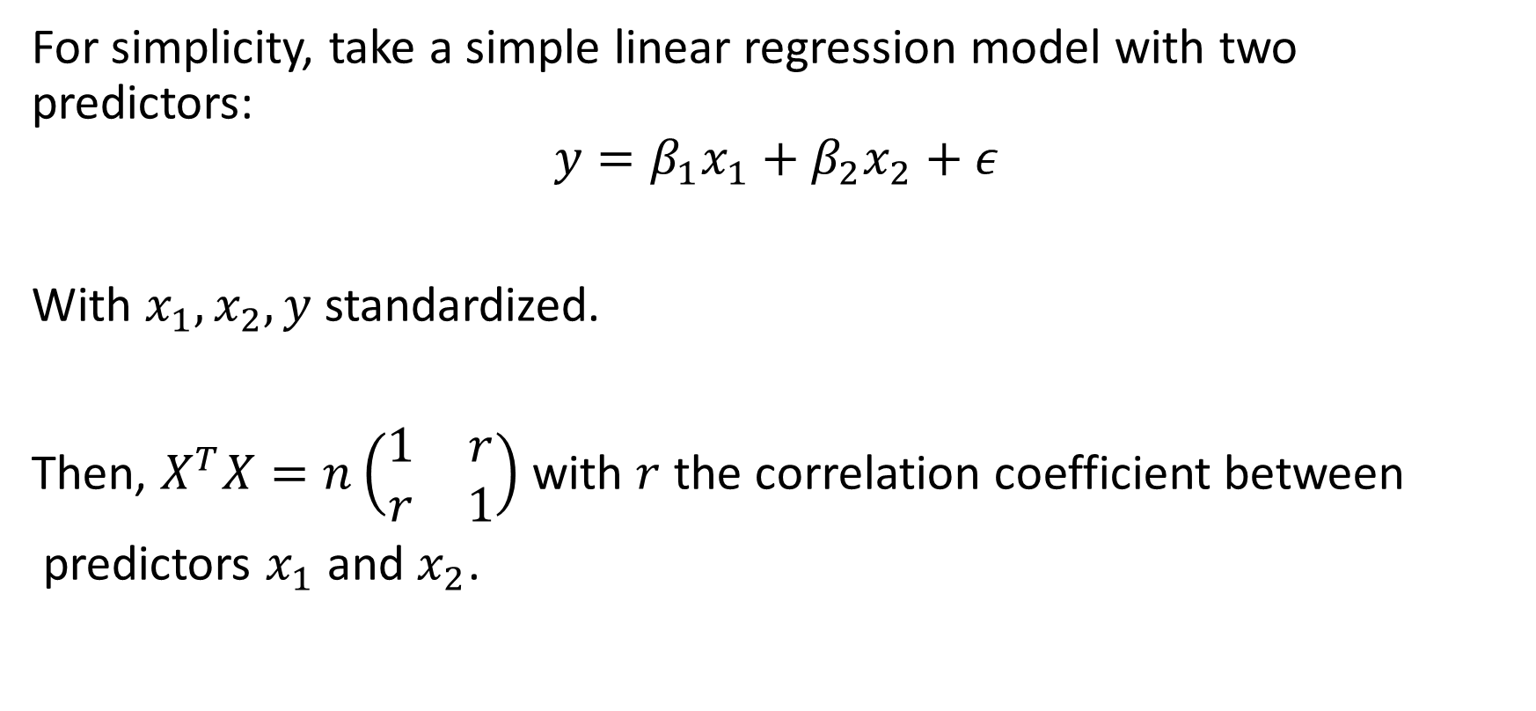
Multicollinearity
For simplicity, take a simple linear regression model with two predictors:
$$y=β_{1}x_{1}+β_{2}x_{2}+ε$$
With $x_{1},x_{2}, y$ standardized.
Then, $X^{T}X=n\left(\begin{matrix}1 & r \\ r & 1\end{matrix}\right)$ with $r$ the correlation coefficient between
predictors $x_{1}$ and $x_{2}$.

Slide 8
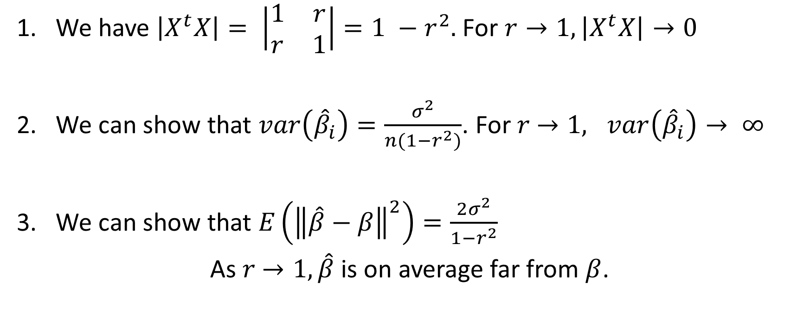
Multicollinearity
We have $\left|X^{t}X\right|= \left|\begin{matrix}1 & r \\ r & 1\end{matrix}\right|=1 −r^{2}.$For $r→1, \left|X^{t}X\right|→0$
We can show that $var\left({\hat{β}}_{i}\right)=\frac{σ^{2}}{n(1−r^{2})}$. For $r$ $→1, var\left({\hat{β}}_{i}\right)→ ∞$
We can show that $E\left({\left\|\hat{β}−β\right\|}^{2}\right)=\frac{2σ^{2}}{1−r^{2}}$
As $r$ $→1, \hat{β}$ is on average far from $β$.

Slide 9
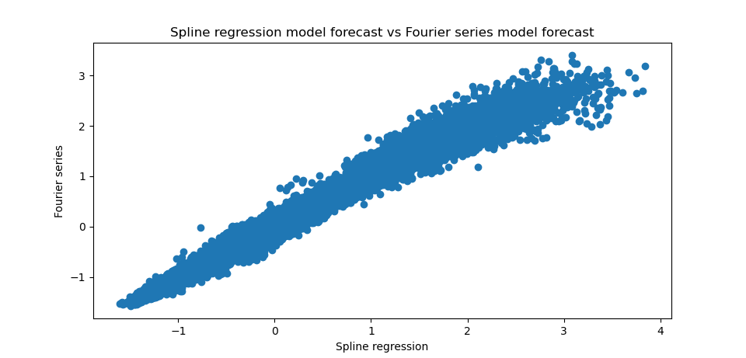
Multicollinearity
For a time window of 30 days, correlation coefficient between any two models varies between 0.90 and 0.99.

Slide 10
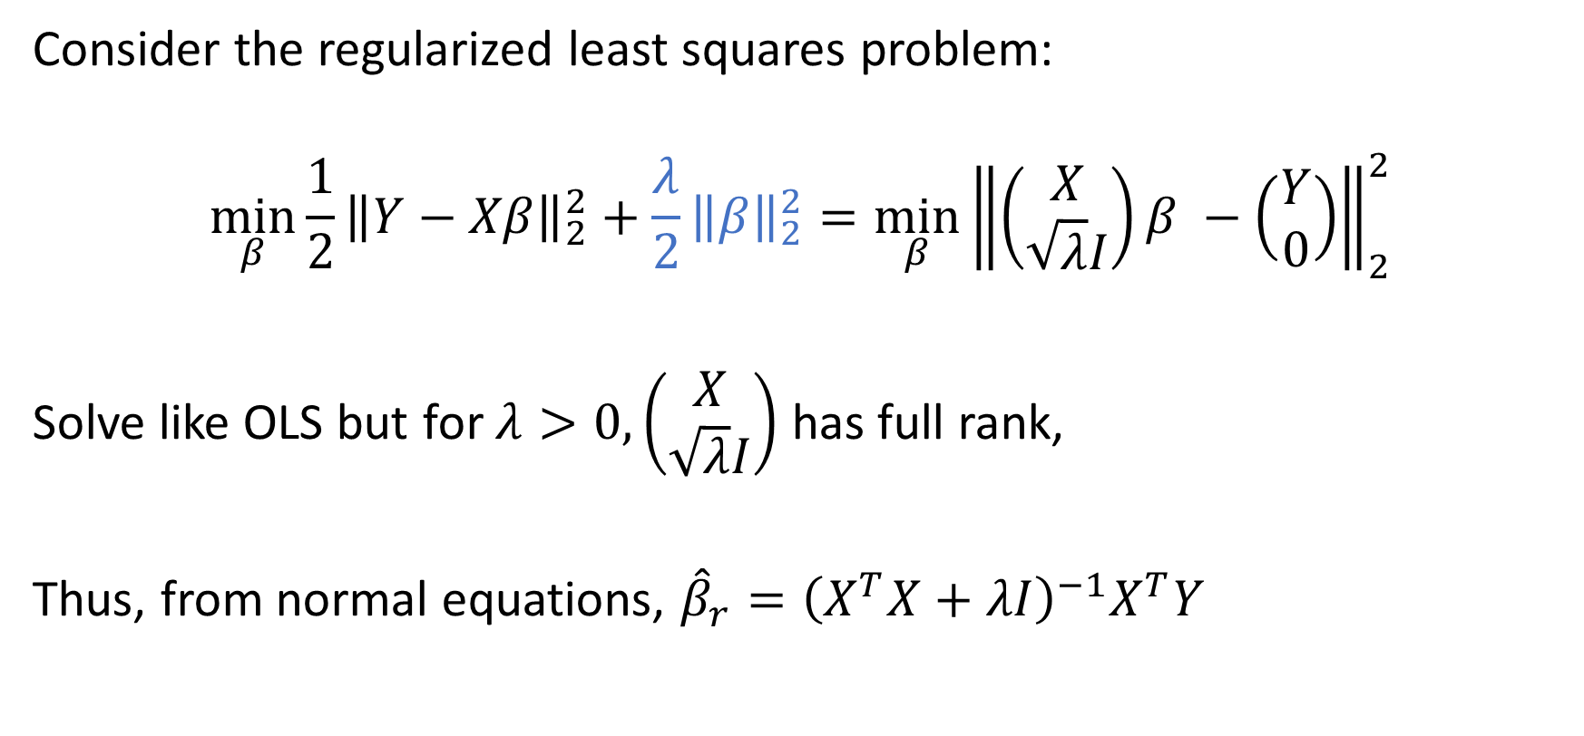
Regularization
Consider the regularized least squares problem:
$$\min_{β}{\frac{1}{2}{\left\|Y−Xβ\right\|}_{2}^{2}+\frac{λ}{2}{\left\|β\right\|}_{2}^{2}}=\min_{β}{{\left\|\left(\begin{aligned}X \\ \sqrt{λ}I\end{aligned}\right)β −\left(\begin{aligned}Y \\ 0\end{aligned}\right)\right\|}_{2}^{2}}$$
Solve like OLS but for $λ>0, \left(\begin{aligned}X \\ \sqrt{λ}I\end{aligned}\right)$ has full rank,
Thus, from normal equations, ${\hat{β}}_{r}={\left(X^{T}X+λI\right)}^{−1}X^{T}Y$

Slide 11
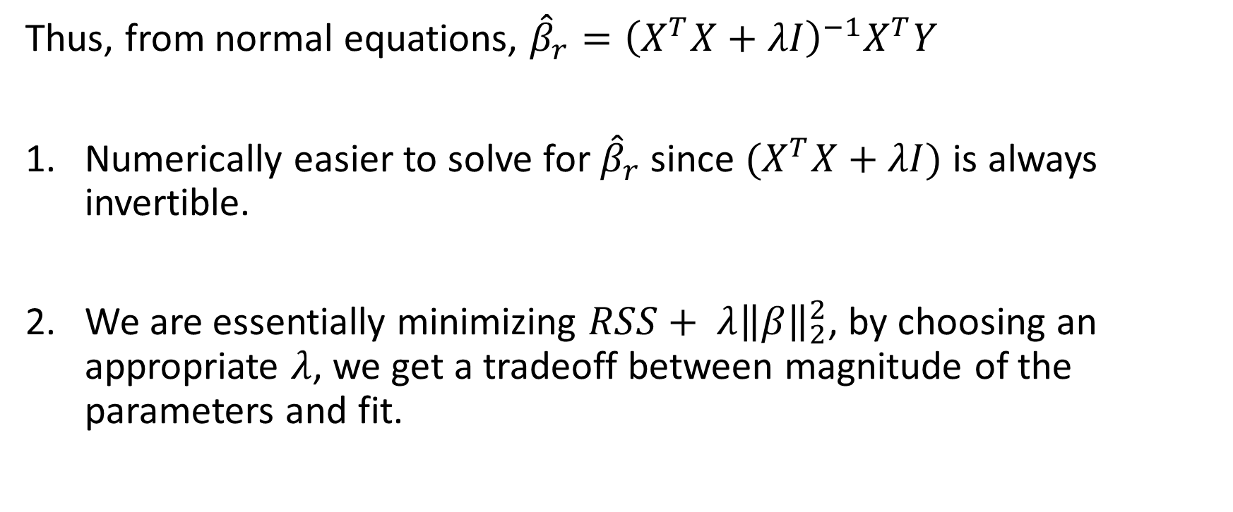
Regularization
Thus, from normal equations, ${\hat{β}}_{r}={\left(X^{T}X+λI\right)}^{−1}X^{T}Y$
Numerically easier to solve for ${\hat{β}}_{r}$ since $(X^{T}X+λI)$ is always invertible.
We are essentially minimizing $RSS+ {λ\left\|β\right\|}_{2}^{2}$, by choosing an appropriate $λ$, we get a tradeoff between magnitude of the parameters and fit.

Slide 12
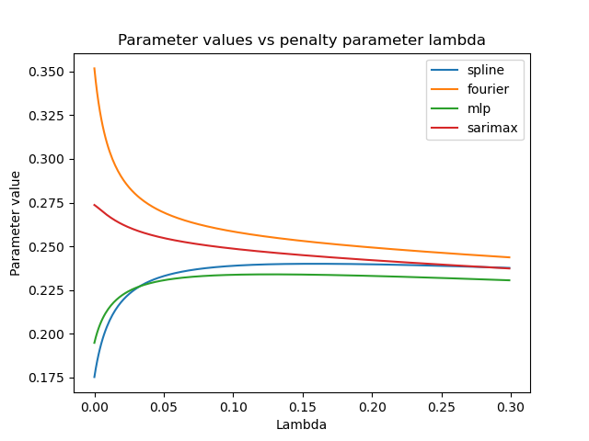
Regularization

Slide 13
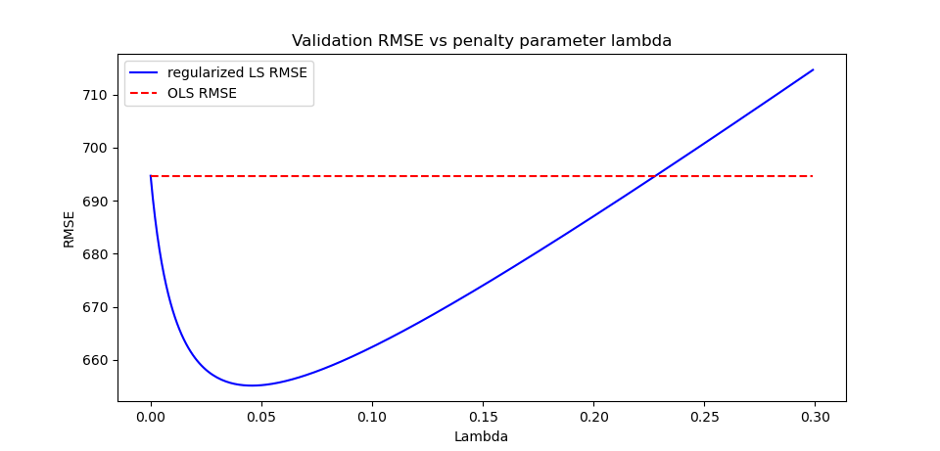
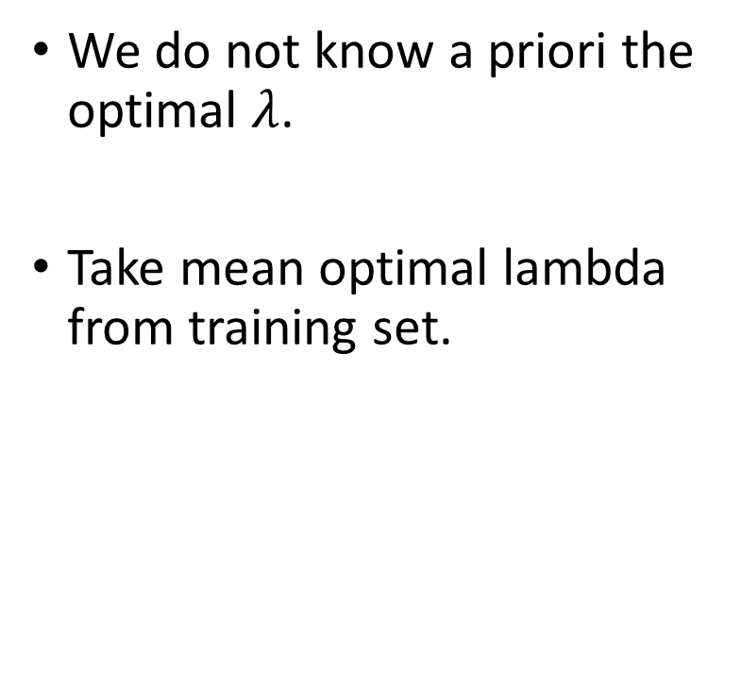

Regularization – Determining $λ$
We do not know a priori the optimal $λ$.
Take mean optimal lambda from training set.

Slide 14
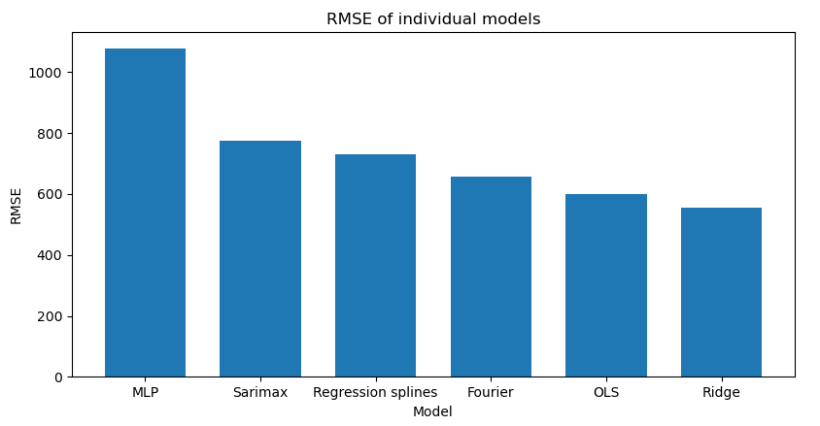
Results

Slide 15
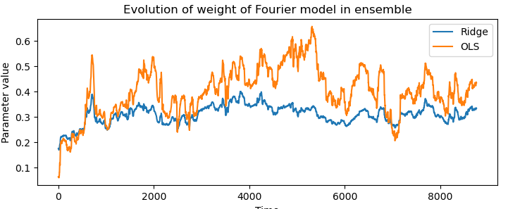
Results

Slide 16
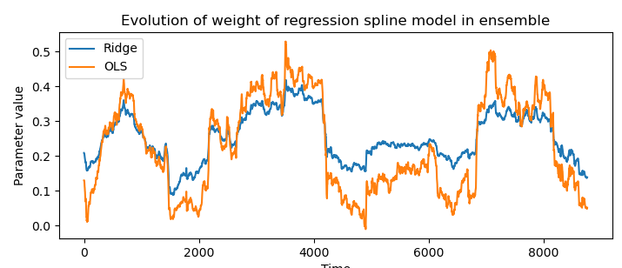
Results

